Slide 1
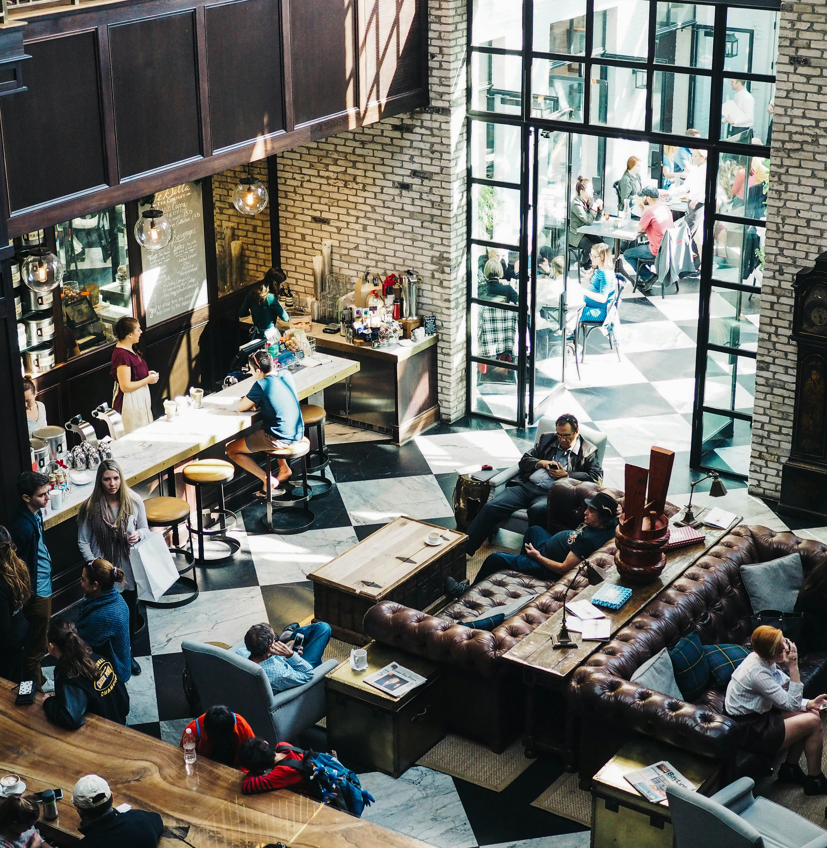

COFFEE SHOP REVIEW ANALYSIS
Ziwei Guo & Tai Nguyen

Slide 2
Research/analysis goals
This project focuses on analyzing Yelp reviews of coffee shops in Austin, TX, aiming to uncover insights into customer perceptions and preferences
By employing statistical techniques such as sentiment analysis, classification modeling, feature importance analysis, topic modeling and regression analysis, we seek to understand factors that influence overall ratings and categorical ratings of coffee shops. The goal is to provide actionable insights to coffee shop owners in Austin or coffee business owners in general, helping them enhance customer satisfaction and optimize business strategies.

Slide 3
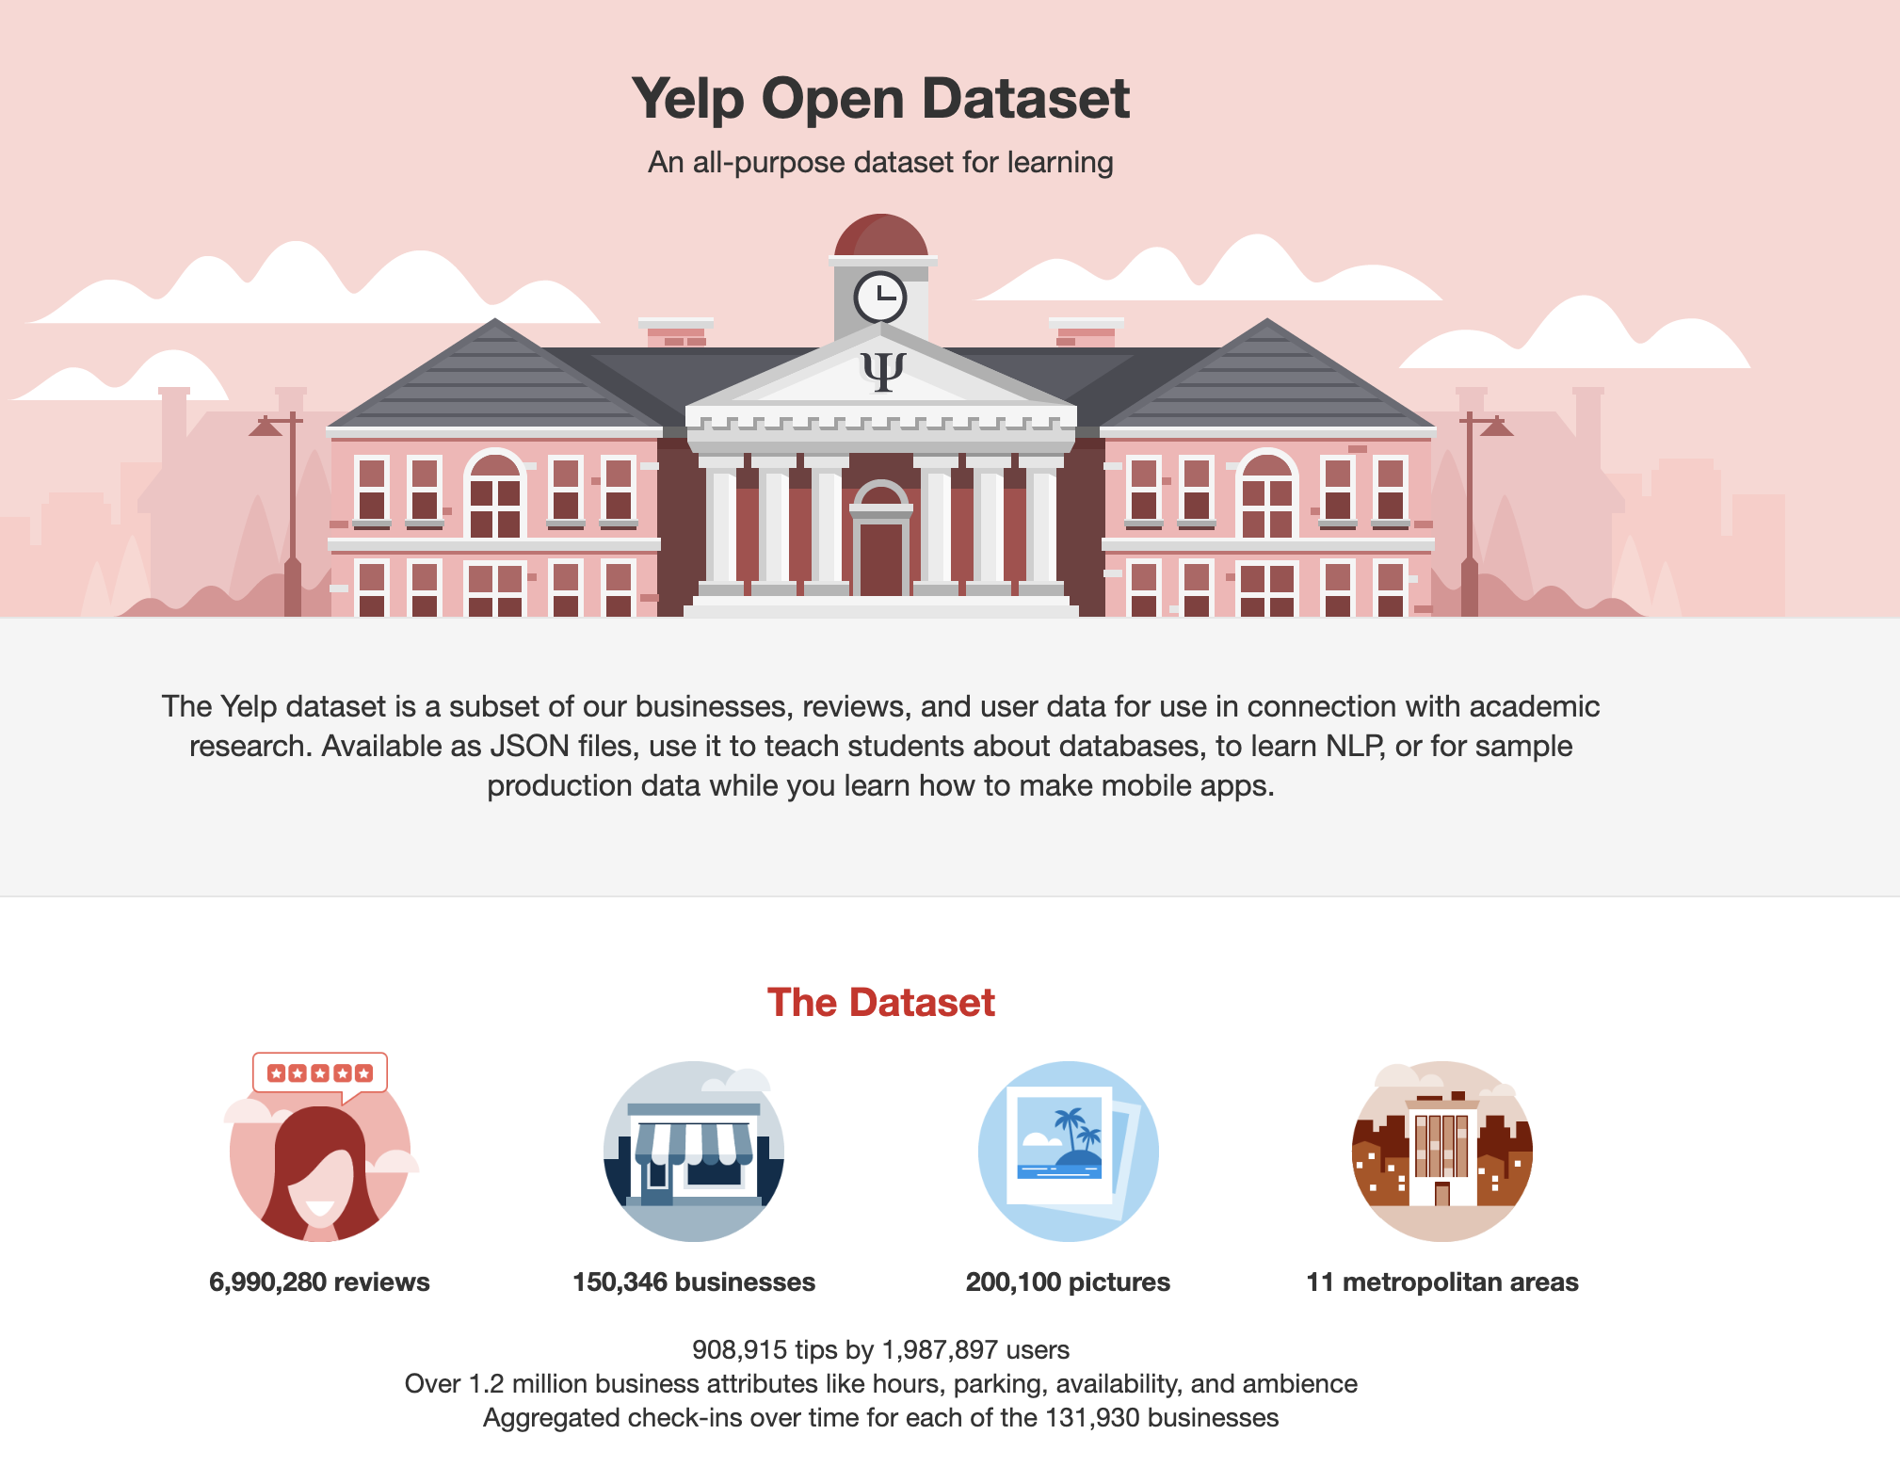
Data Retrieval
Original: Yelp Open Dataset
Problems: too large (4GB and all in JSONs)
Selected: https://www.kaggle.com/datasets/sripaadsrinivasan/yelp-coffee-reviews/code

Slide 4
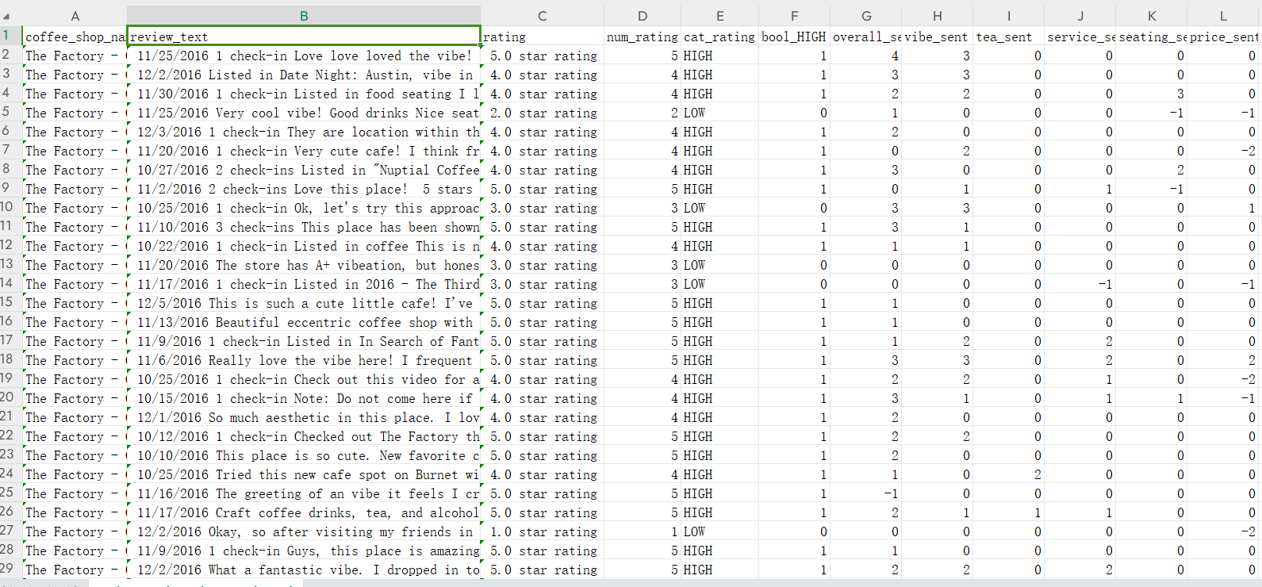
Data Description
3 datasets
Nearly 7000 scraped reviews about 78 coffee shops in Austin, TX with various sentiment parameters
Includes 20 variables consisted of 4 types:
Numerical
Categorical
String (Text)
Date

Slide 5
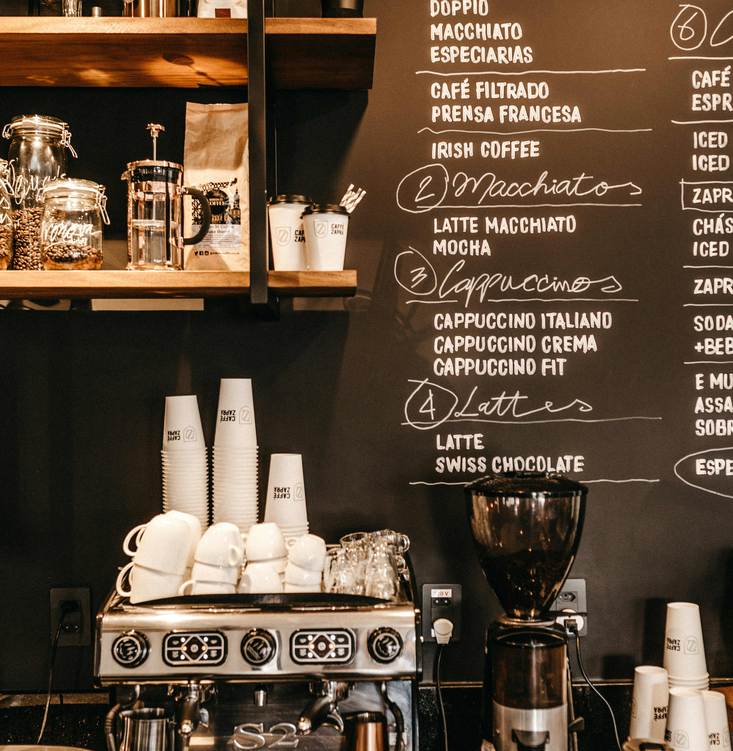
Exploratory Data Analysis

Slide 6
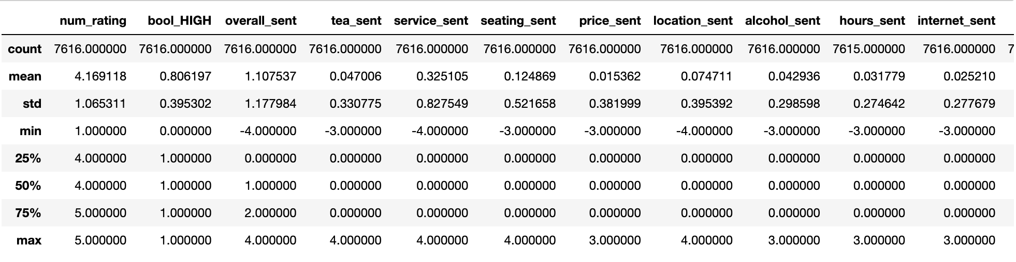
Descriptive statistics

Slide 7
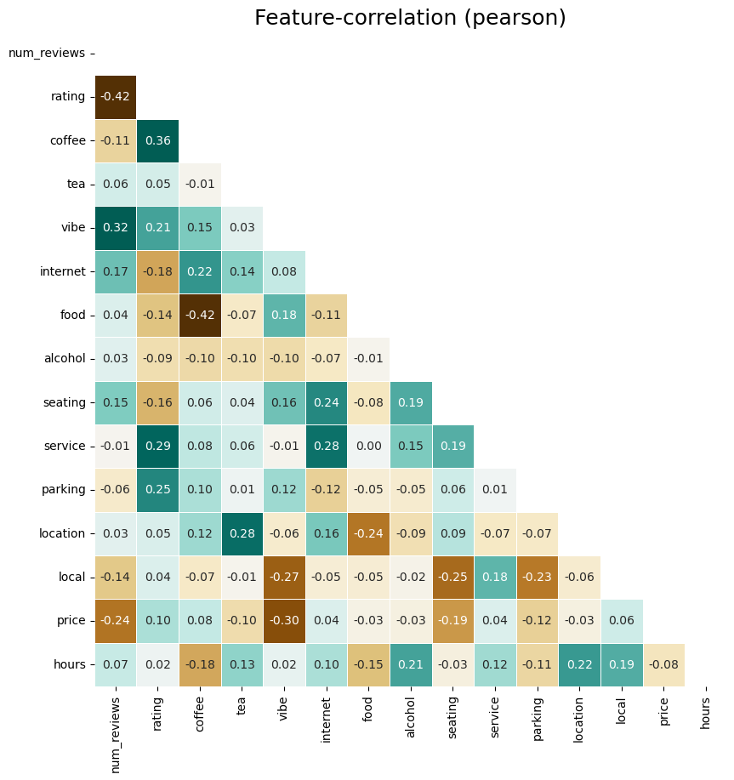
Feature Coefficient Matrix/heatmap
Identify patterns and relationships between variables. High absolute values of correlation coefficients (close to 1 or -1) indicate strong relationships, while values close to 0 suggest weak or no relationships.

Slide 8
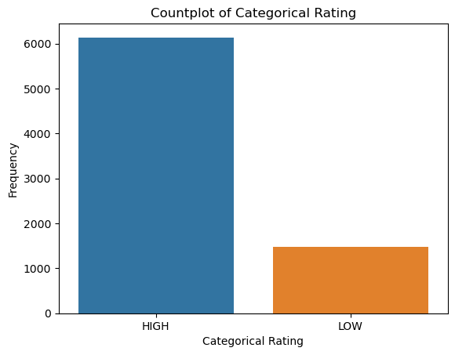
Distribution of Categorical Rating

Slide 9
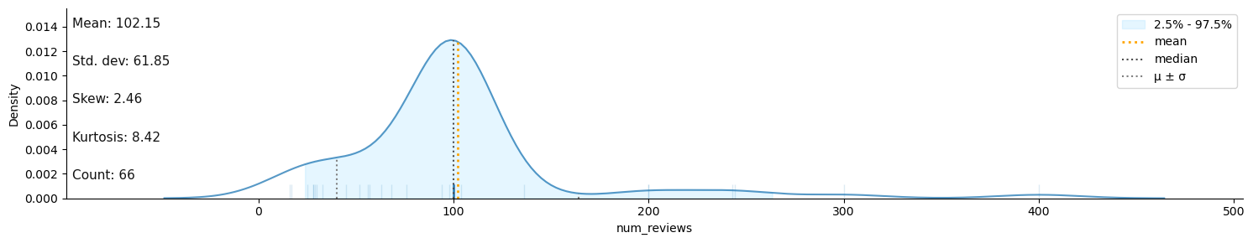
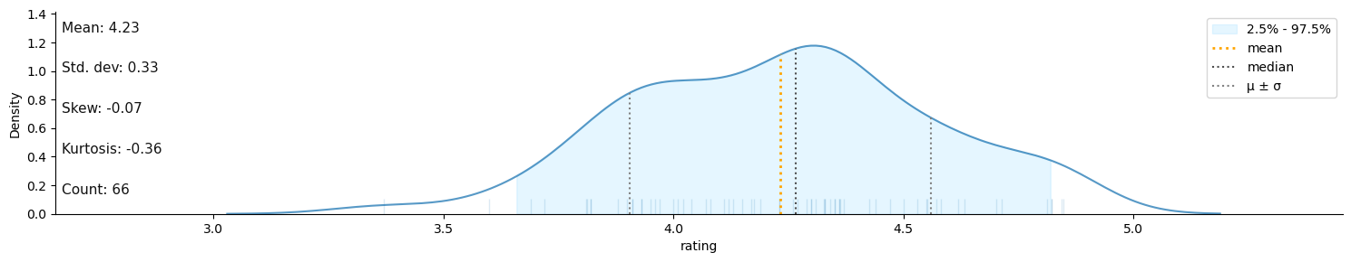
Distributions of num_reviews and ratings across the 78 coffee stores

Slide 10
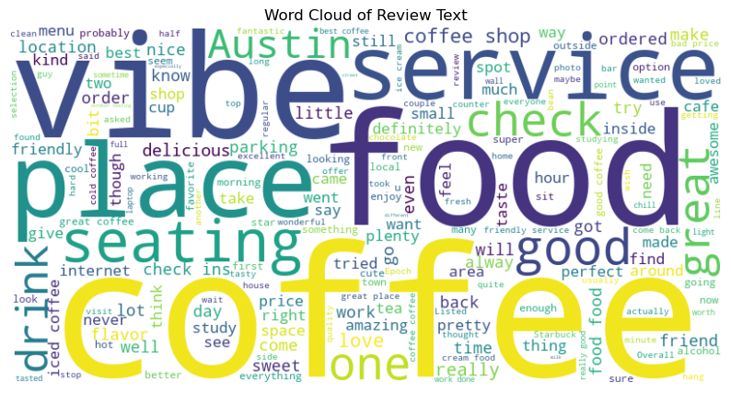
Word Cloud

Slide 11

Analysis Methodology
Logistic Regresion
Feature Importance
Text/sentiment Analysis

Slide 12
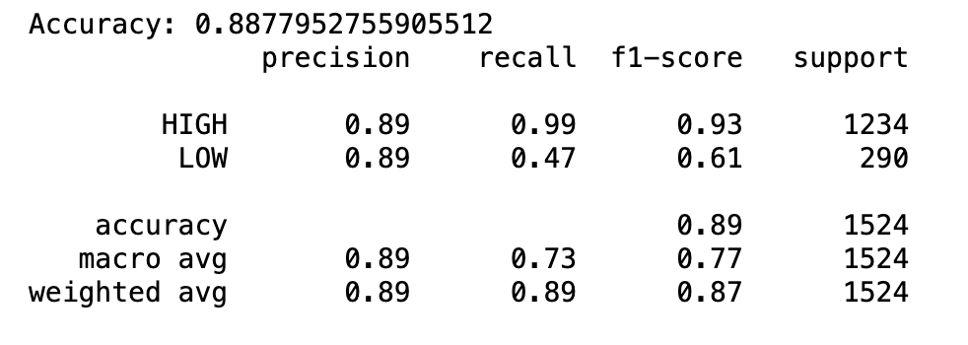
Logistic Regression
Prediction of categorical rating (HIGH or LOW) based on review text and other features
Load the dataset containing the reviews and the target variable into a Pandas DataFrame.
Define the features (review text) and the target variable (categorical rating).
Split the dataset into training and testing sets using train_test_split() function.
Use TF-IDF vectorizer to convert the text data into numerical features.
Build a logistic regression model using LogisticRegression() class from scikit-learn.
Make predictions on the test set using the trained model.
Evaluate the performance of the model using accuracy score and classification report, which provides precision, recall, and F1-score for each class.

Slide 13
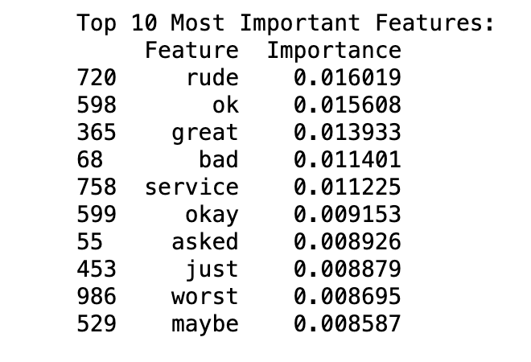
Feature Selection through Random Forest
Identify the most important features (e.g., specific words in the review text, numerical ratings) that contribute to the overall rating or categorical rating of the coffee shop
Load the dataset containing the reviews and the target variable into a Pandas DataFrame.
We define the features (review text) and the target variable (categorical rating).
We split the dataset into training and testing sets using train_test_split() function.
We use TF-IDF vectorizer to convert the text data into numerical features.
For decision tree, we build a decision tree classifier using DecisionTreeClassifier() class from scikit-learn.
For random forest, we build a random forest classifier using RandomForestClassifier() class from scikit-learn.
We make predictions on the test set using the trained models.
We evaluate the performance of the models using accuracy score and classification report, which provides precision, recall, and F1-score for each class.

Slide 14
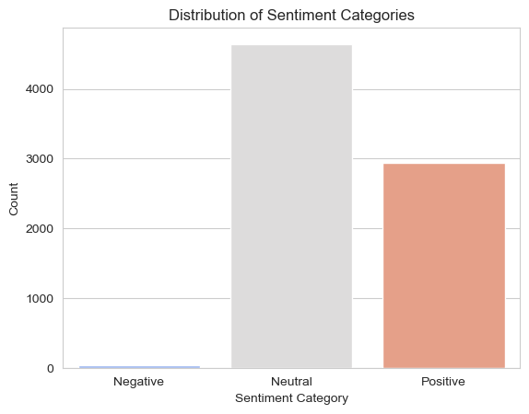
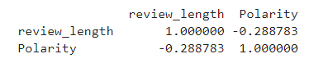
Polarity score within the range [-1, 1]
Sentiment Analysis
Correlation table

Slide 15
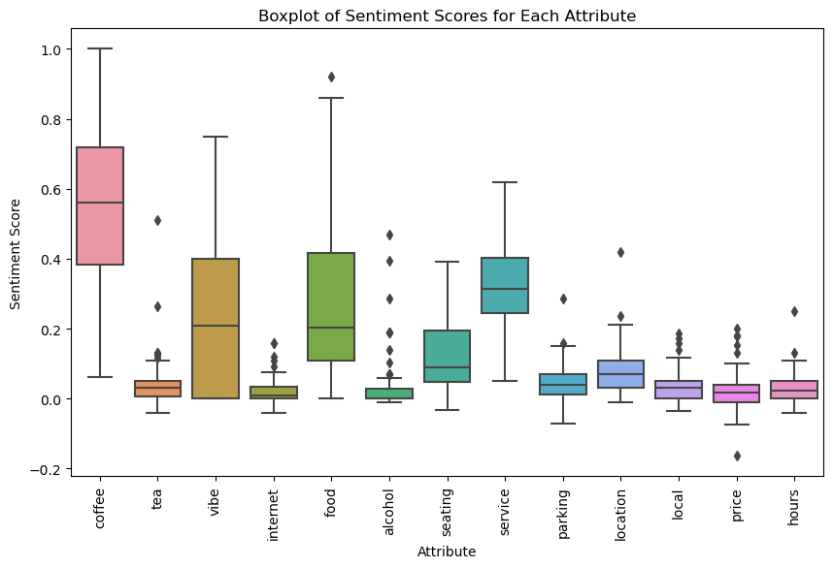
Sentiment Scores For Each Attribute

Slide 16
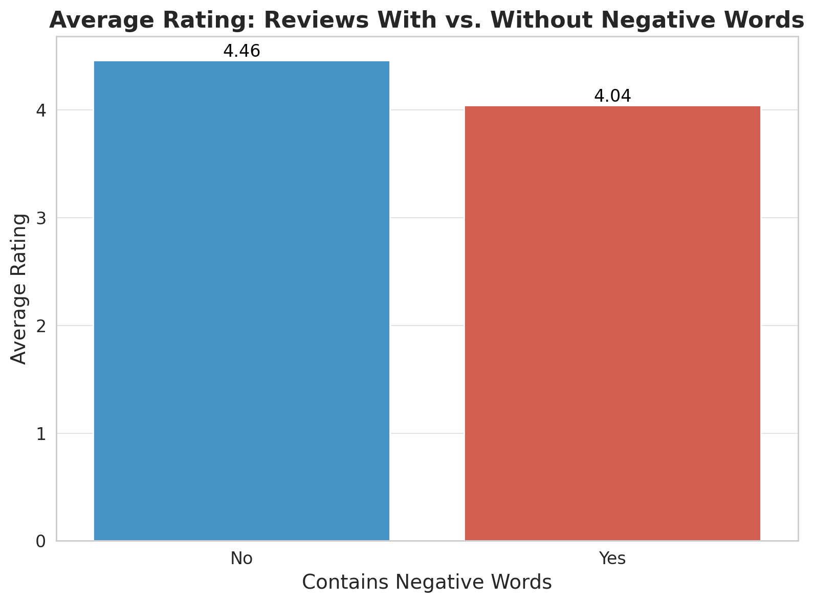
Negative words like 'not', "don't", "doesn't", 'never', 'no', 'cannot', "can't", 'lack', 'without'
Sentiment Analysis

Slide 17
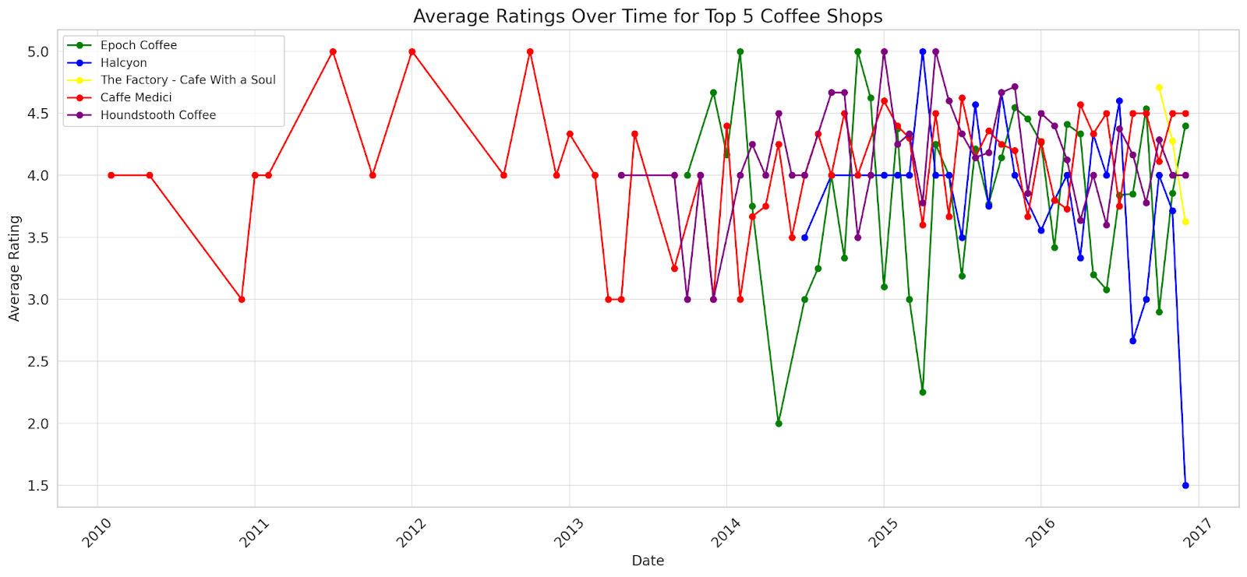
Sentiment Analysis – A Time Perspective

Slide 18
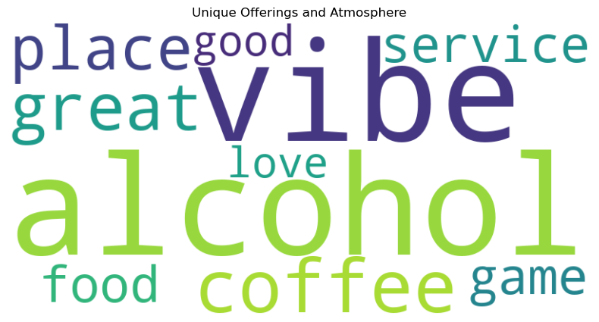
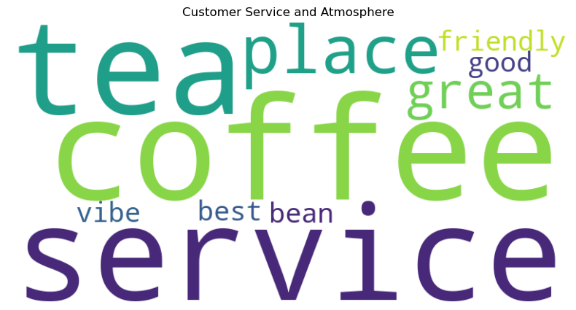
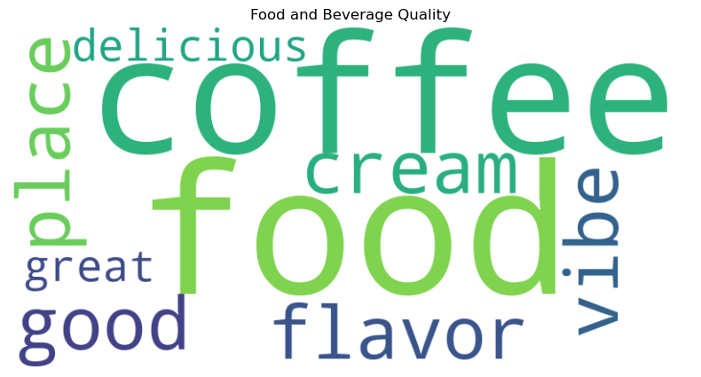

Word cloud under topics

Slide 19
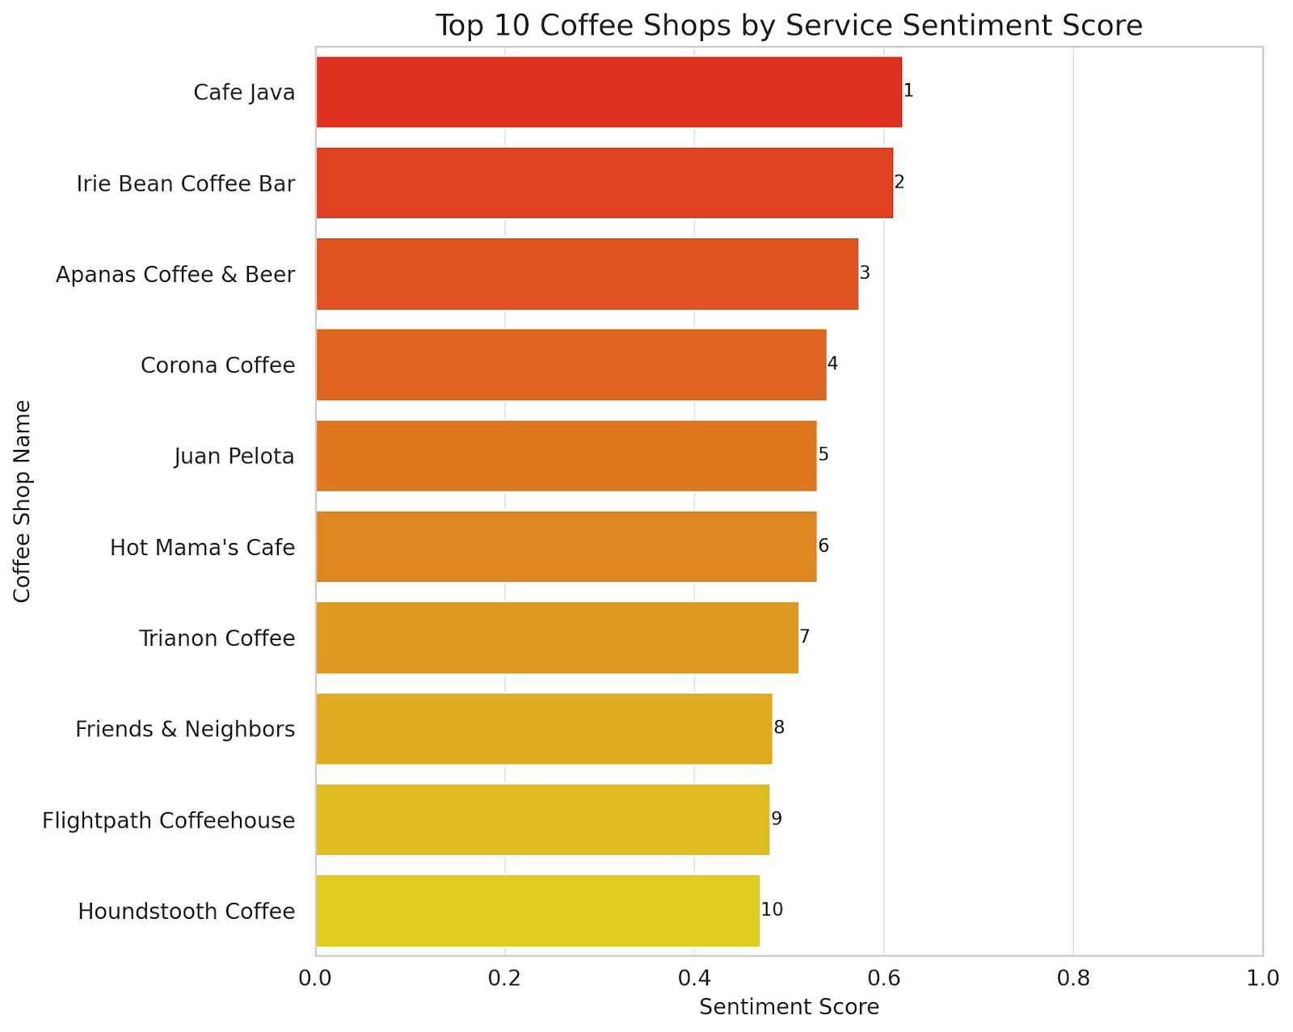
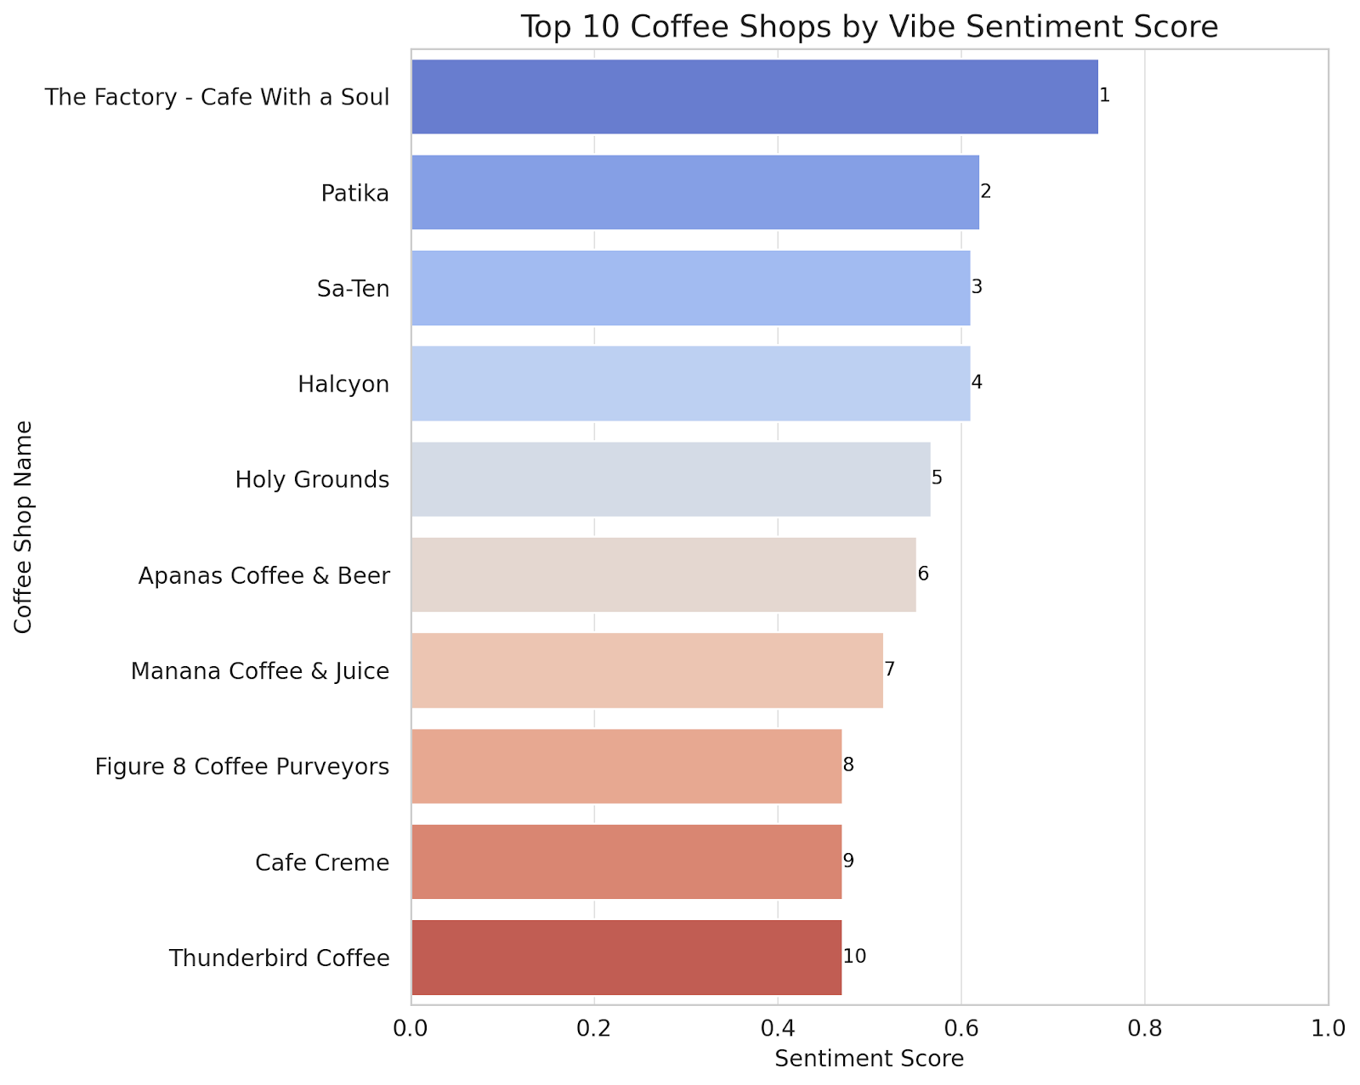
Rank by attributes

Slide 20
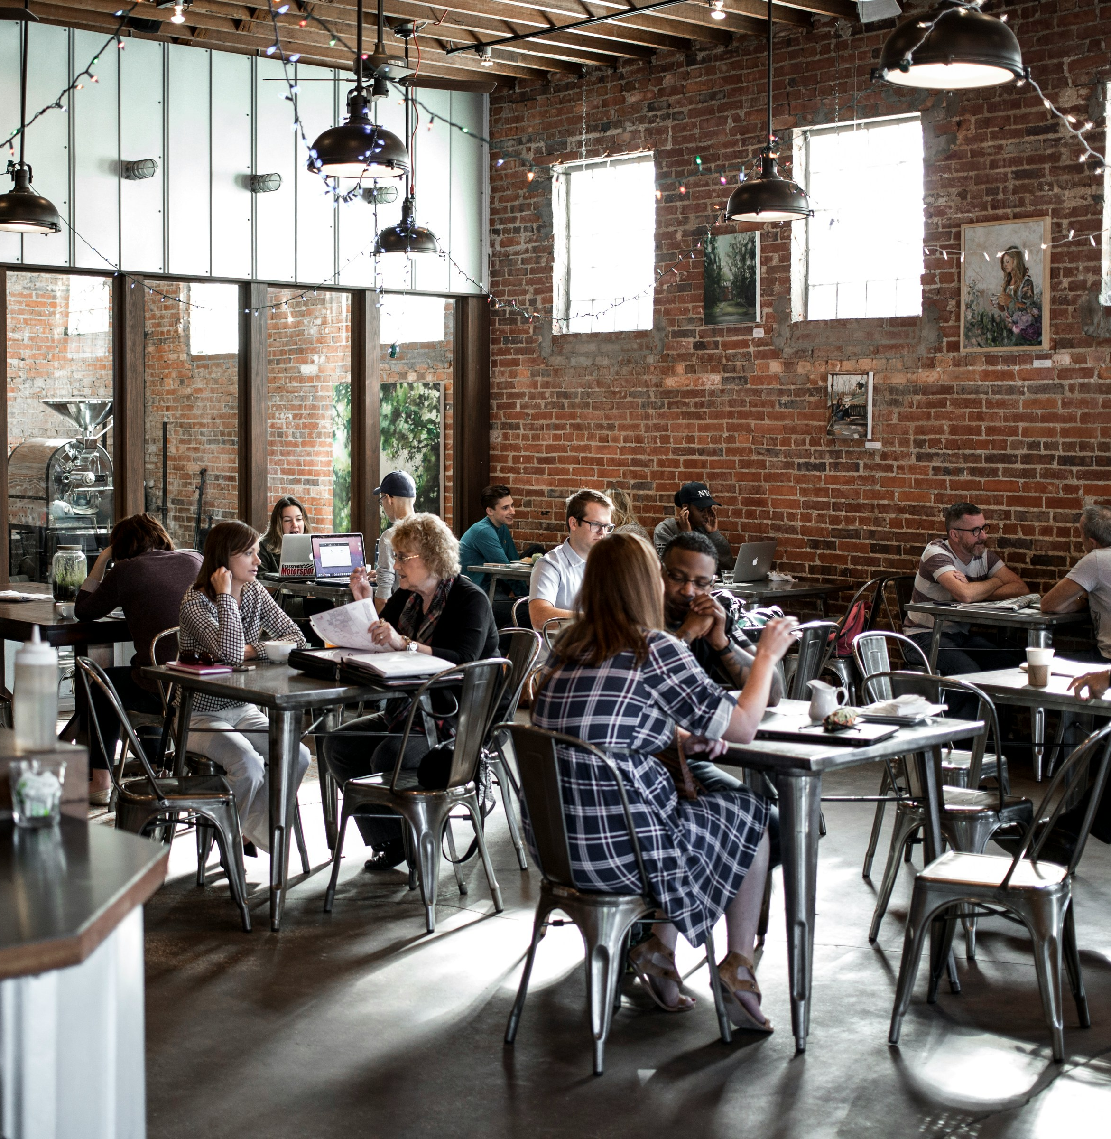
Implication for Stakeholders

Slide 21
Implications for stakeholders
Enhanced Customer Satisfaction: Understand factors for positive experiences, leading to happier customers.
Improved Business Strategies: Informed decisions on offerings, pricing, and marketing for better outcomes.
Targeted Marketing: Tailor messaging and promotions to resonate with the audience.
Operational Efficiency: Identify areas for improvement, streamlining processes for cost savings.
Competitive Advantage: Stand out in the market by adapting to customer preferences effectively.

Slide 22

Ethical, legal and societal implications

Slide 23
Ethical, legal and societal implications
Privacy: Uphold customer privacy rights by safeguarding their personal information and ensuring anonymity in data analysis.
Representation: Strive for a balanced representation of diverse perspectives and experiences within the dataset to avoid skewing analysis outcomes.
Transparency: Maintain transparency in data collection, preprocessing, and analysis methods to foster trust and accountability in research practices.
Security: Implement robust data security measures to protect the dataset from unauthorized access, ensuring the confidentiality and integrity of sensitive information.
Bias: Recognize and mitigate biases that may arise from factors like demographics or cultural backgrounds to provide impartial and accurate insights.
Business Impact: Consider the potential effects of analysis findings on coffee shop owners, including competitive dynamics and market trends, to inform responsible decision-making.
Responsibility: Embrace the ethical responsibility of researchers to utilize data ethically and responsibly, considering the broader societal implications of their analysis.

Slide 24
Incoming works
Dashboard: build a comprehensive/interactive Power BI/Tableau viz to present descriptive findings
Text mining and NLP: extract insights from the review text, such as identifying frequently mentioned topics, detecting sentiment, or summarizing key themes and opinions expressed by customers.
K-means clustering: group similar reviews together based on their features or sentiment scores. This can help identify distinct customer segments or patterns in the data.
Regression Analysis: understand the relationship between independent variables (e.g., specific aspects of the coffee shop experience) and the dependent variable (e.g., overall rating)
…

Slide 25
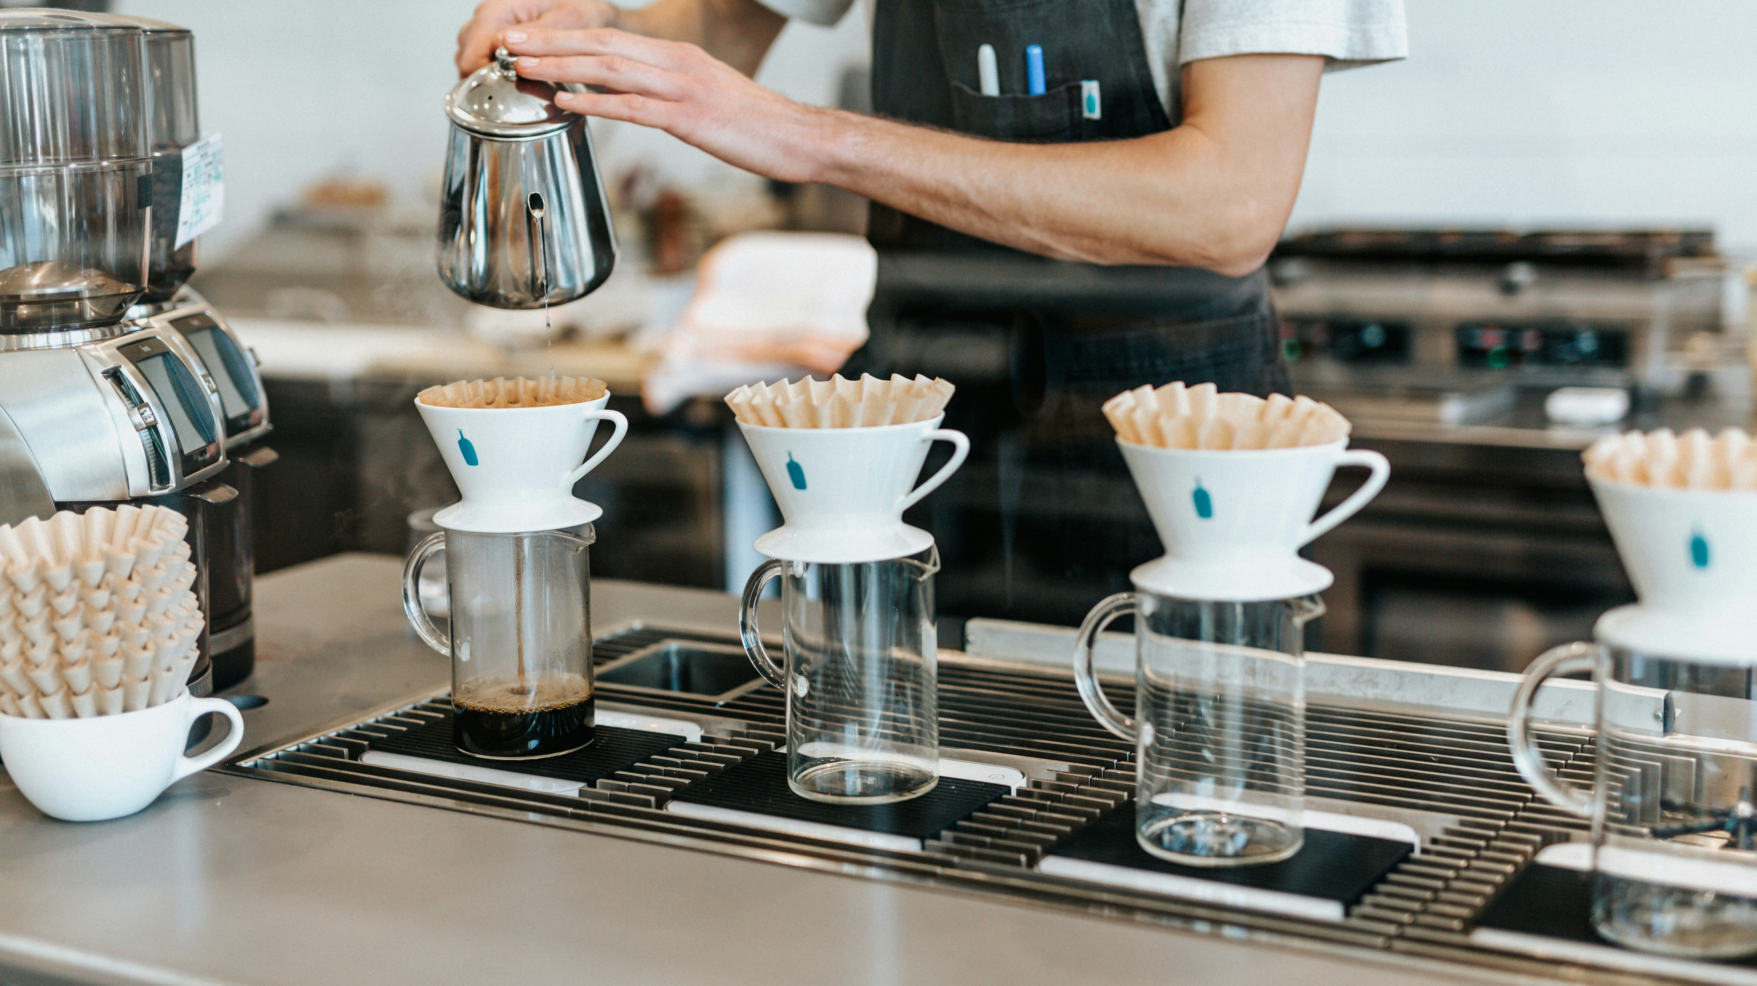
Thank you for listening!
All images source: unsplash.com

